Slide 1
AUTO1 Inventory Performance Insights
Sandeep Uprety
01/11/2025

Slide 2


CONTENTS
01
Project Overview
02
Key Performance Metrics
03
Pricing and Market Alignment
04
Strategic Recommendations
05
Technical Implementation
06
Conclusion and Next Steps

Slide 3


01
Project Overview

Slide 4

AUTO1 Inventory Performance Insights
An Analysis of Retail Inventory Across European Markets
Scope
Approximately 1,000 car listings from October to December 2024, covering AUTO1’s European retail markets.
Objective
Tools Used
Outcome
Understand how pricing, brand mix, and time-on-market affect profitability and sales speed.
Actionable insights to improve inventory turnover, liquidity, and pricing strategy.
Python for data manipulation, SQL for analysis, and Tableau for visualization.

Slide 5
Dataset Overview and Variables
Dataset Snapshot
Key Variables & Derived Metrics
Core Variables:
The analysis is based on a comprehensive dataset of car listings from AUTO1's retail inventory.
• Manufacturer • Model
• Fuel Type • Buy Price
• Listed Price • Market Reference Price
• First Online Date • Sale Date
Period: Oct–Dec 2024
Sample Size: ~1,000 car listings
Dataset Profile
Total records: approximately 1,000 car listings from October to December 2024.
Coverage: AUTO1’s European retail inventory.
About 46 percent of cars were sold during the period, providing a balanced view of active and completed listings.
Derived Metrics:
Gross Margin % = (Listed Price – Buy Price) ÷ Buy Price
Price Gap % = (Listed Price – Market Reference Price) ÷ Market Reference Price
Days on Market = Sale Date – First Online Date

Slide 6
02
Key Performance Metrics

Slide 7
Inventory Performance Overview
999
45.6%
~40
Total Cars
Sell-Through Rate
Avg. Days to Sell
39.6%
-1%
Competitive pricing supports fast sales while sustaining strong profitability.
Avg. Gross Margin
Avg. Price Gap

Slide 8
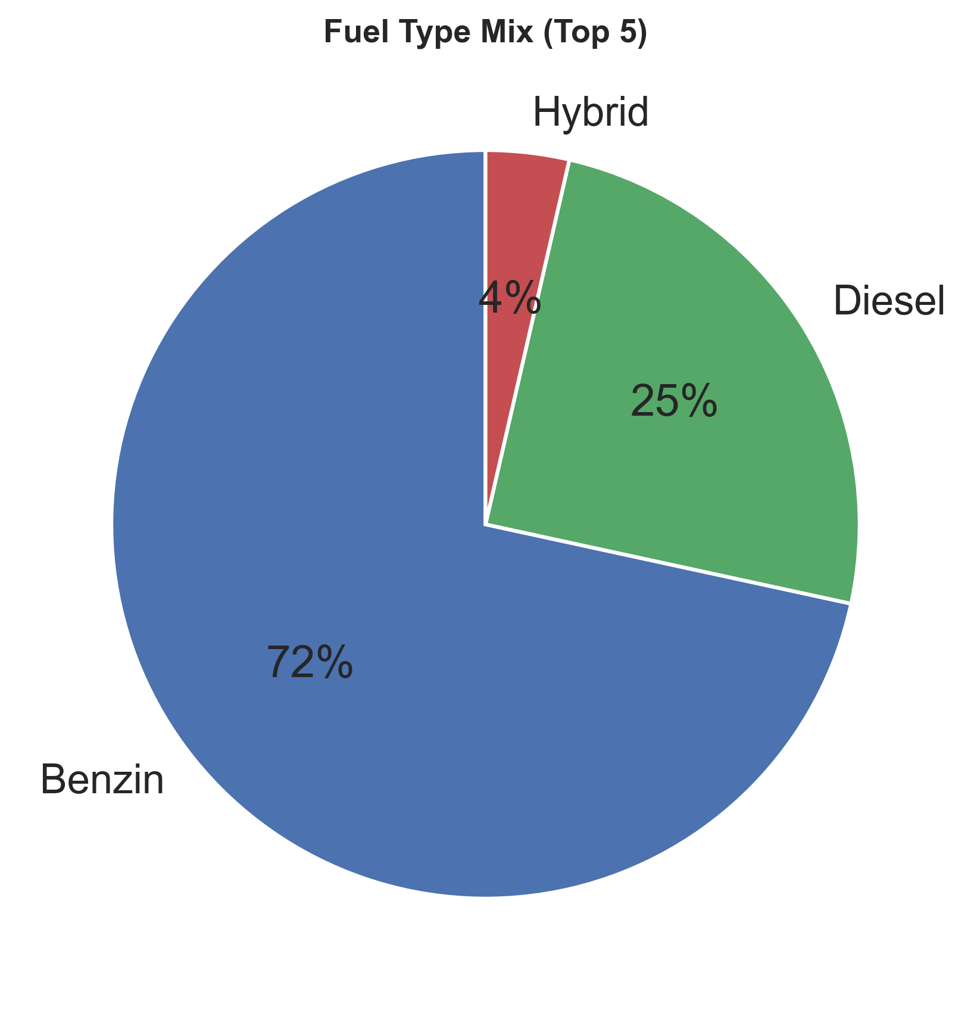
Fuel Type and Brand Mix
Key Takeaway
Align sourcing and pricing strategies with fast-turnover, high-margin brands to maximize profitability and inventory efficiency.
Fuel Type Distribution
Petrol: ≈72%
Diesel: ≈25%
Hybrid/Electric: Small share
Top-Margin Brands
SsangYong
Citroën
Fiat
SsangYong achieves the highest average gross margin (≈ 92 percent), followed by Citroën and Fiat. High-margin brands tend to sell faster, highlighting an opportunity to focus sourcing and pricing on these manufacturers.

Slide 9
03
Pricing and Market Alignment

Slide 10
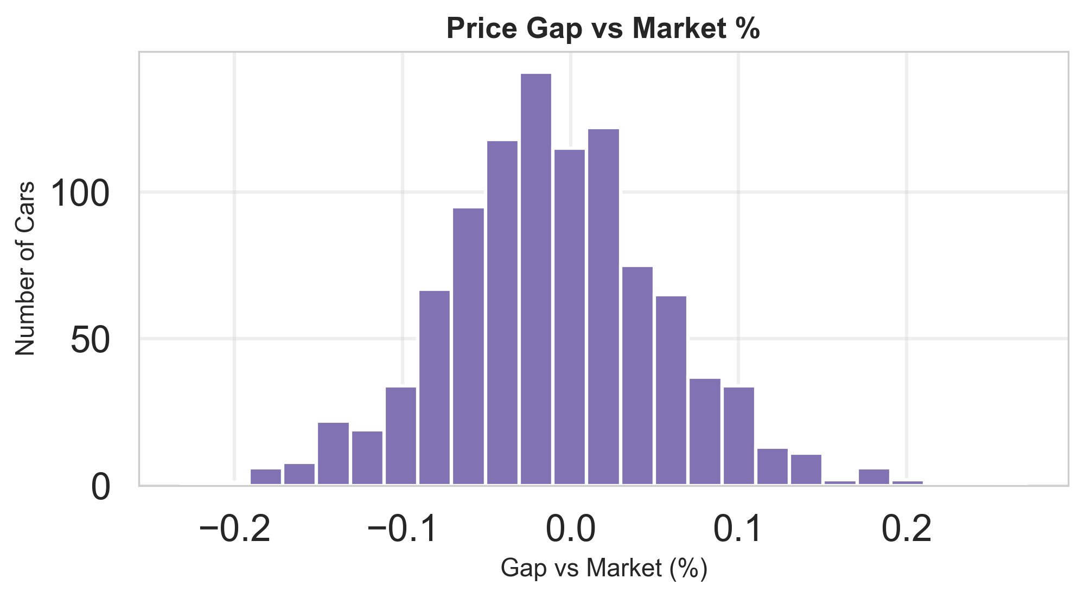
Pricing vs External Market
-1%
Average Price Gap
(Listed vs Market Reference)
Key Insight
Slight underpricing accelerates sales while preserving strong profitability.
Recommendation
Test modest price increases for fast-selling models to optimize margins.
Market Positioning
Most listings are priced close to the external market average, with a small overall gap of around –1 %.This pricing strategy keeps AUTO1 competitive and supports faster sales.

Slide 11

Liquidity and Inventory Age
A significant portion of capital is tied up in aged inventory, slowing turnover and impacting liquidity.
544 Cars listed for >90 days
€7.8M in tied-up capital
Recommendation: Focused repricing or targeted campaigns for aged stock.

Slide 12
04
Strategic Recommendations

Slide 13
Strategic Recommendations
Short-Term
Medium-Term
Long-Term
Reprice or promote vehicles listed for more than 90 days to clear aged inventory and unlock tied-up capital.
Automate Tableau dashboards for weekly performance monitoring. Set measurable goals, for example, at least 50% of cars sold within 30 days, to maintain consistent improvement.
Concentrate on high-performing brands with faster turnover and stronger margins. Enhance data quality for buy prices and market benchmarks to ensure accurate KPI tracking.

Slide 14
Technical Implementation
→
→
Data Preparation (Python)
Analysis Layer
Visualization
Cleaned and standardized raw data. Created derived variables including is_sold, days_on_market, gross_margin_pct and price_gap_vs_market_pct.
Developed SQL queries to calculate key KPIs such as average margin, price gap and inventory age buckets. Exported clean tables for visualization and further analysis.
Built interactive dashboards highlighting sell-through rate, margin trends, and brand-level performance.
Enabled managers to monitor KPIs and identify high-performing segments.

Slide 15
Summary of Insights
Profitability Remains Strong
Margins average around 40 percent even with slightly lower pricing compared to market benchmarks.
Liquidity Is Constrained by Aged Stock
Over 540 vehicles have been online for more than 90 days, tying up roughly €7.8 million in capital.
Brand Mix Affects Performance
High-margin brands such as SsangYong, Citroën, and Fiat deliver faster sales and stronger returns.
Pricing Strategy Balances Speed and Profit
AUTO1’s slight underpricing accelerates turnover while keeping profitability intact.
Conclusion: Data-driven pricing and sourcing are essential to enhance turnover and liquidity.

Slide 16
05
Strategic Recommendations

Slide 17
Next Steps and Monitoring
1
2
Integrate Findings
Continuous Monitoring
Incorporate key insights into regular pricing reviews and stock management decisions.
Maintain oversight via automated dashboards for sustained performance.
Ongoing, data-driven decision-making is key to long-term success.

Slide 18
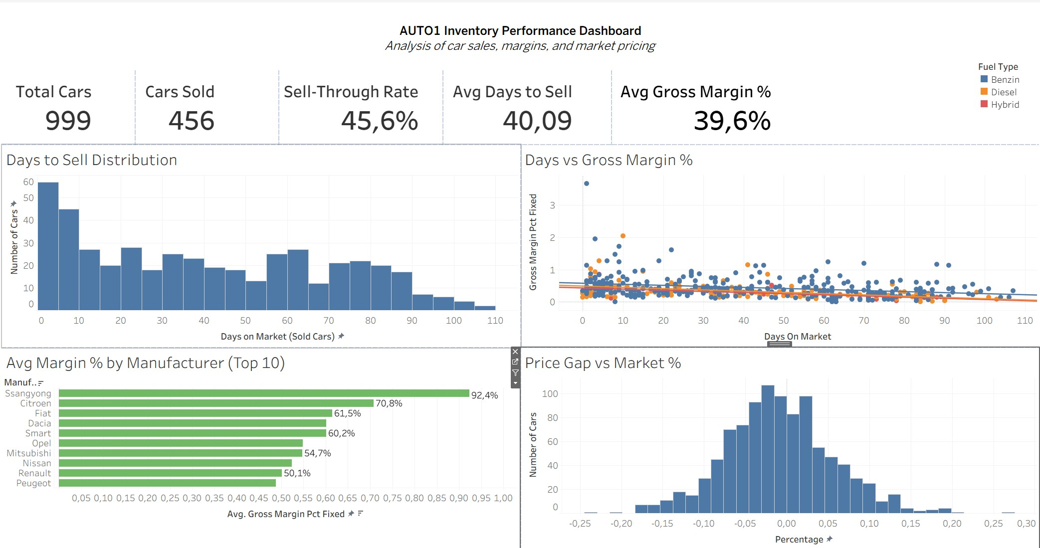
Tableau Dashboard

Slide 19
THANK YOU

